Slide 1
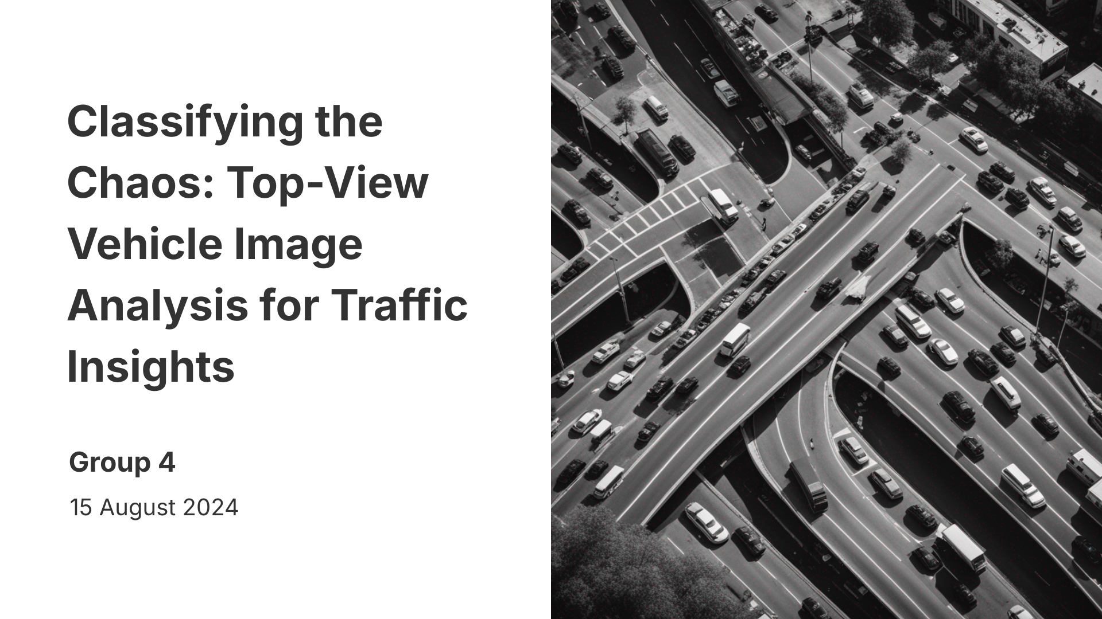
Classification for Traffic situation

Slide 2
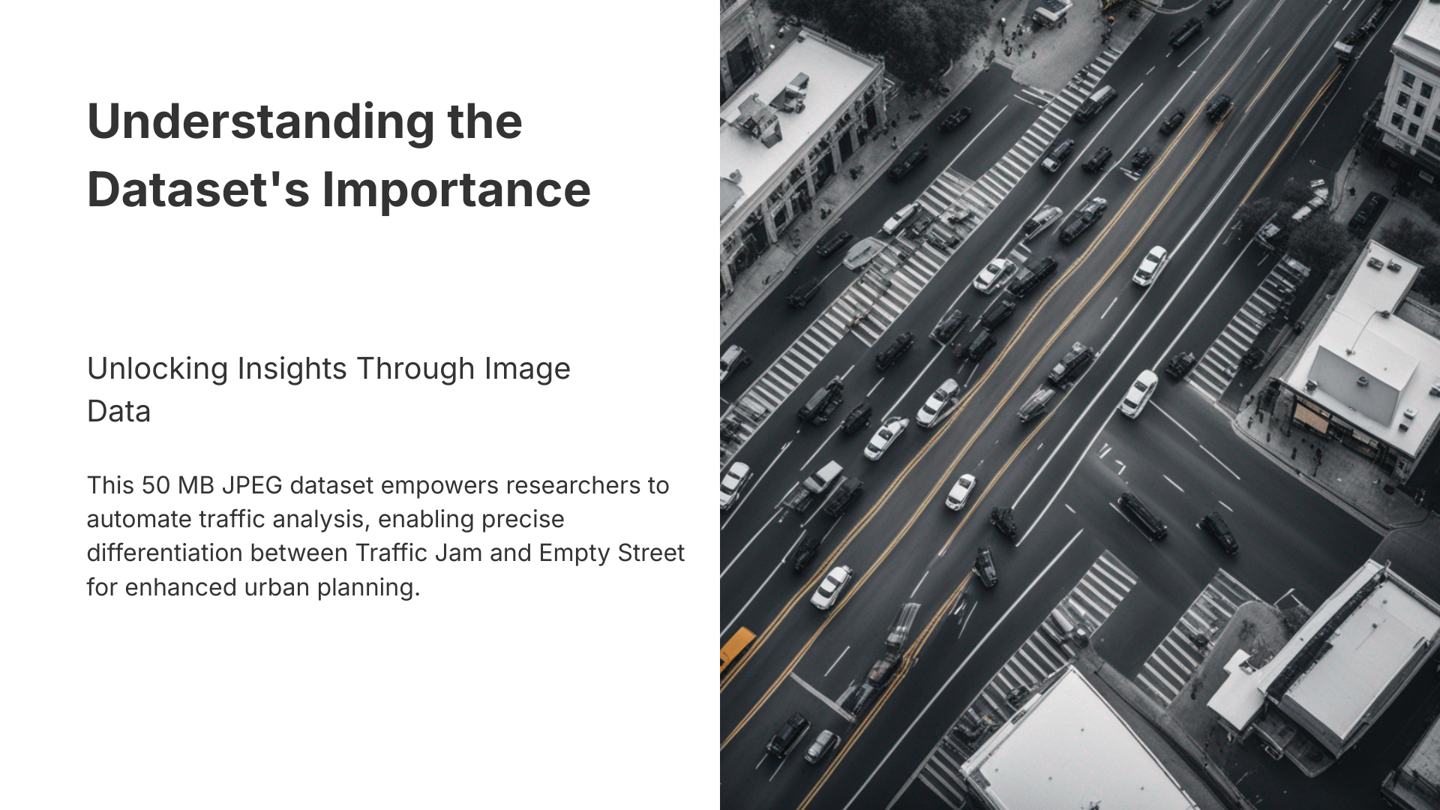
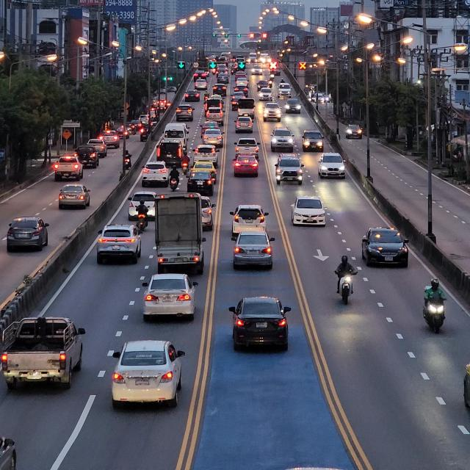
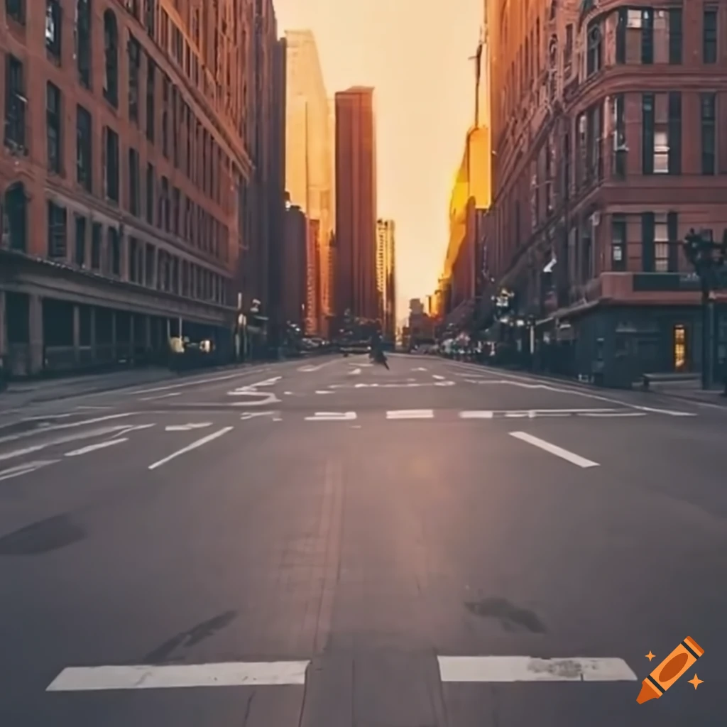
Data collected from google images , and Kaggle data set and manipulate these data as crowded street and empty street

Slide 3
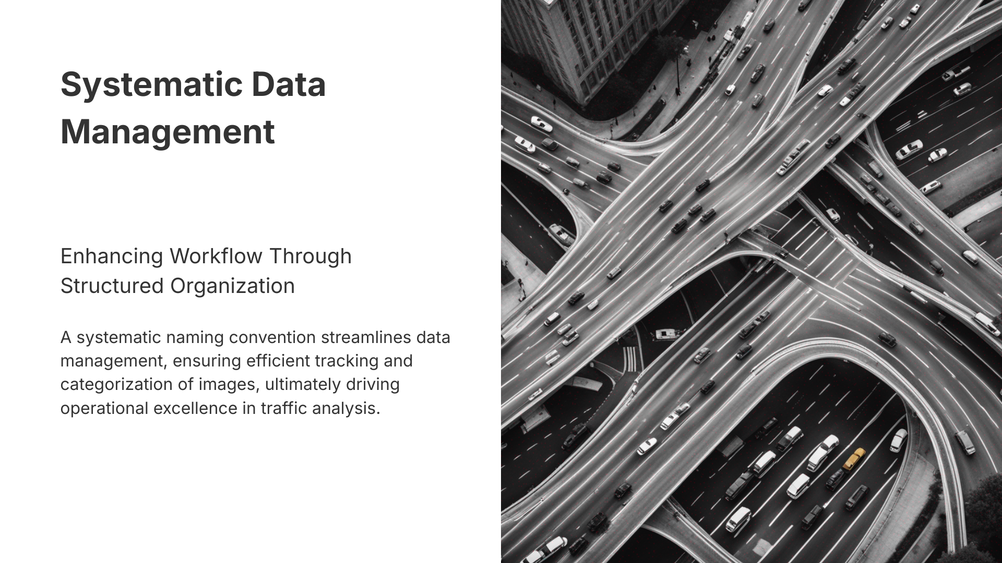
Systematic Data
Augmentation
Rescaleing
Zoom to the image
Horizontal flib

Slide 4
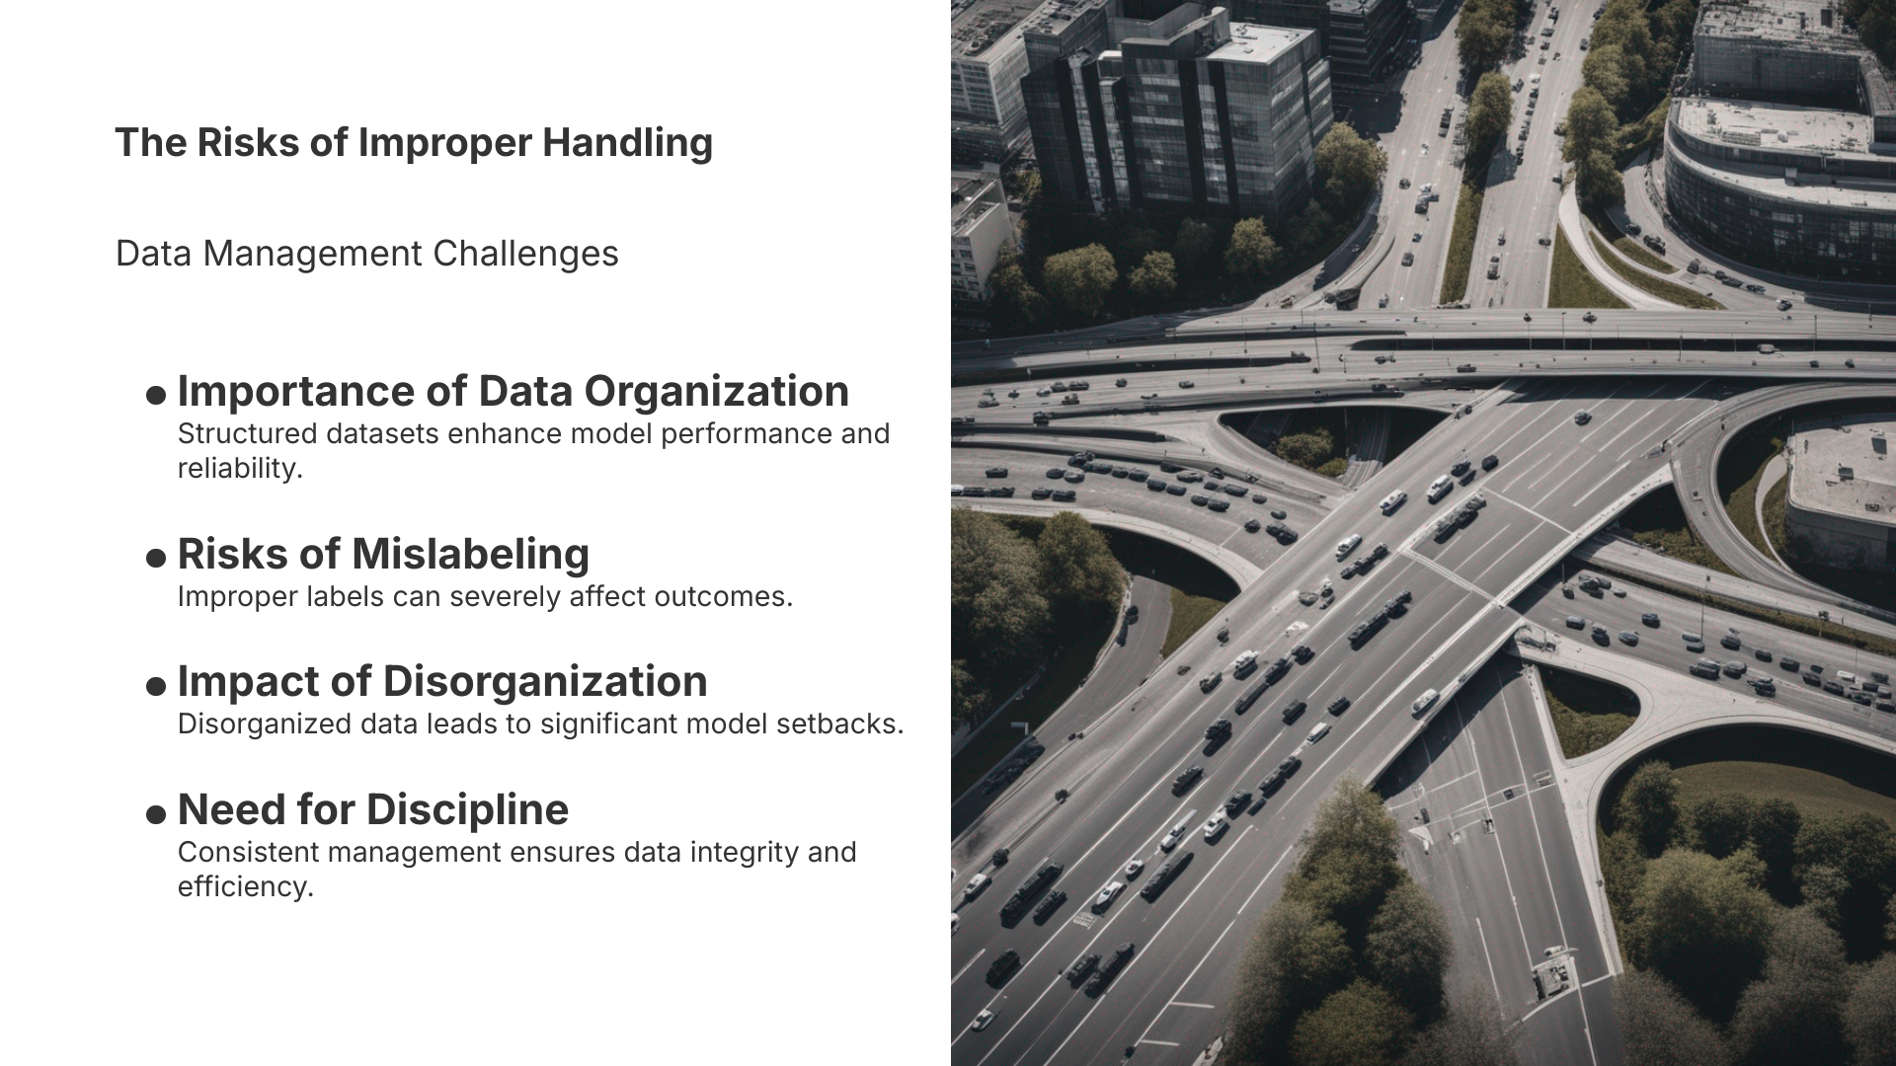
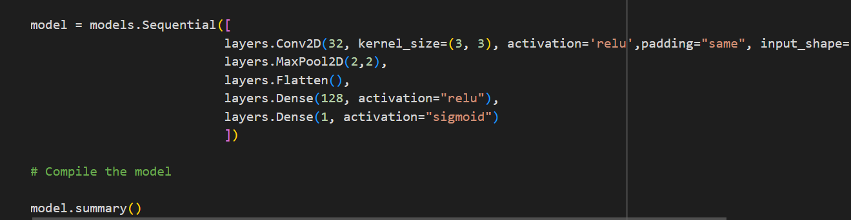
Model selection
We used CNN model for
object detection

Slide 5
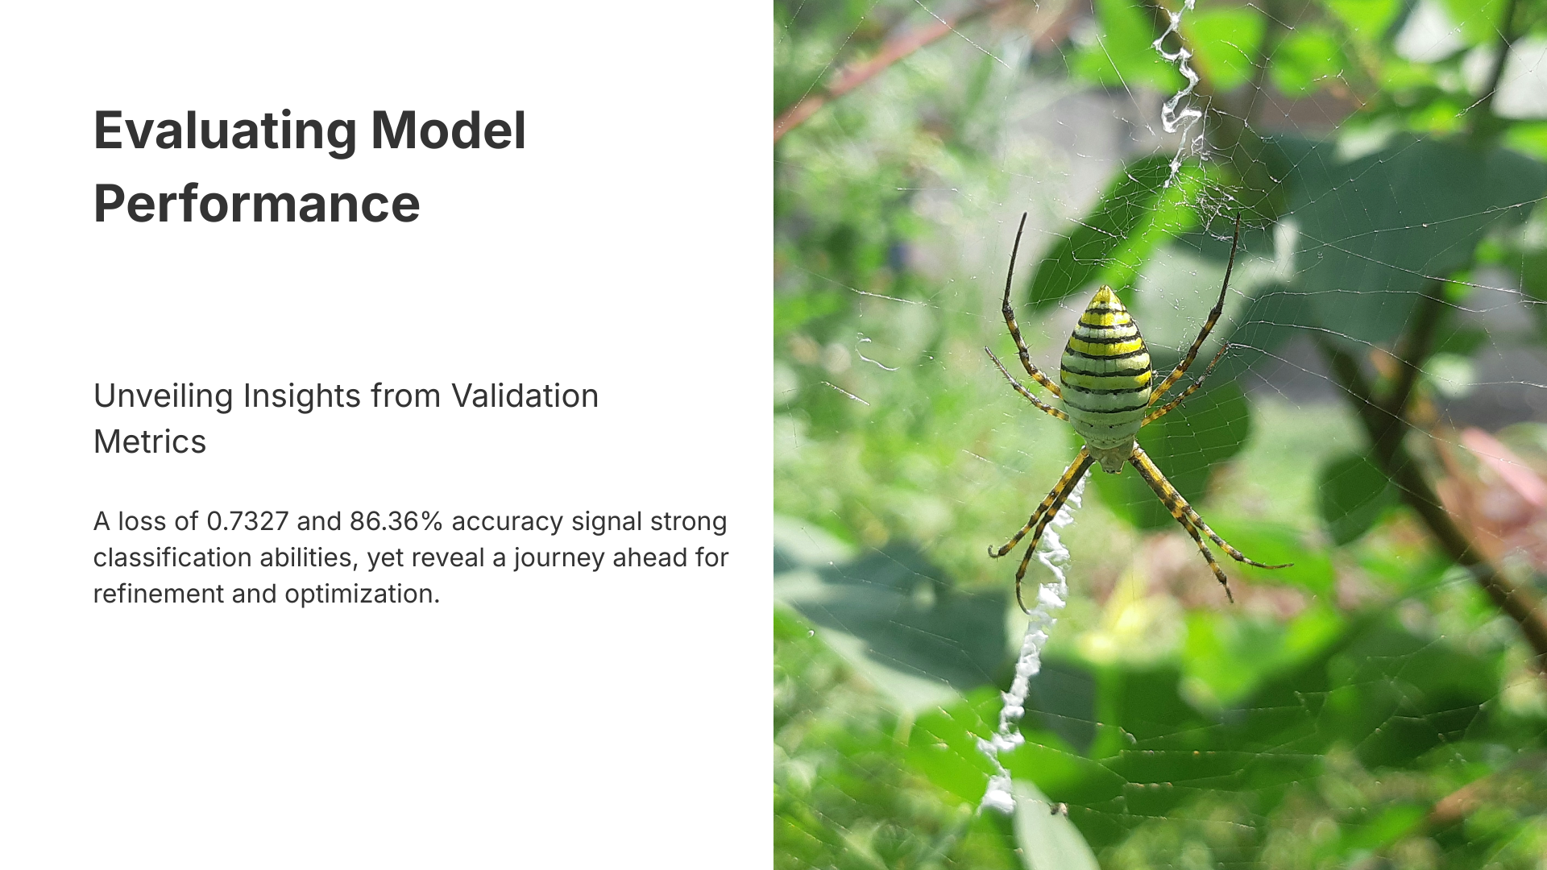
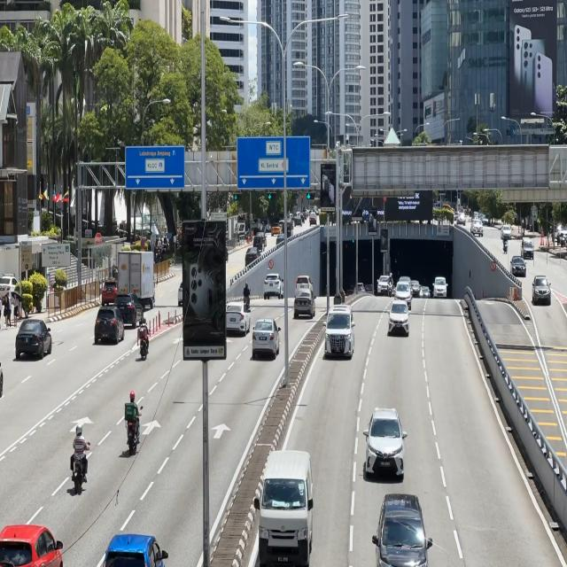

Slide 6
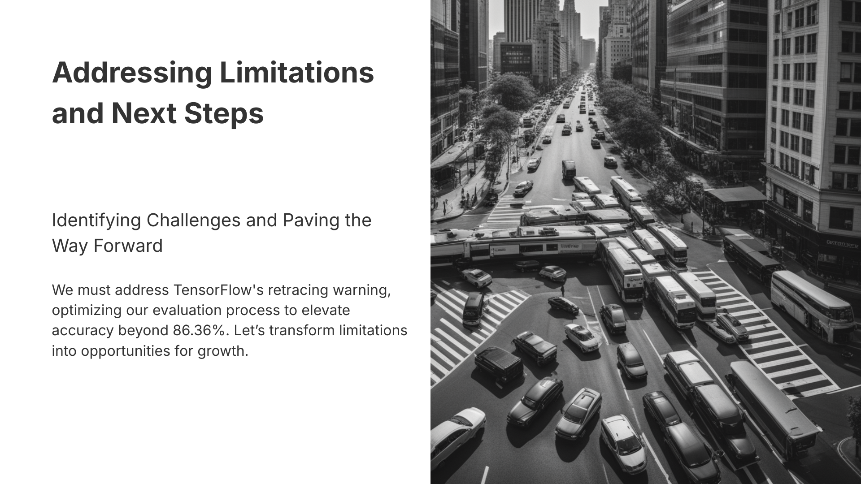
We can collect more data and extract more features , and manipulate the parameters to get better accuracy

